Slide 1
Original Article An Accurate and Rapidly Calibrating Speech Neuroprosthesis
Nicholas S. Card, Ph.D., Maitreyee Wairagkar, Ph.D., Carrina Iacobacci, B.S., Xianda Hou, M.S., Tyler Singer-Clark, B.S., Francis R. Willett, Ph.D., Erin M. Kunz, M.S., Chaofei Fan, M.S., Maryam Vahdati Nia, M.S., Darrel R. Deo, Ph.D., Aparna Srinivasan, M.S., Eun Young Choi, Ph.D., Matthew F. Glasser, M.D., Ph.D., Leigh R. Hochberg, M.D., Ph.D., Jaimie M. Henderson, M.D., Kiarash Shahlaie, M.D., Ph.D., Sergey D. Stavisky, Ph.D., and David M. Brandman, M.D., Ph.D.
N Engl J Med
Volume 391(7):609-618
August 15, 2024

Slide 2
Study Overview
In a man with impaired speech from amyotrophic lateral sclerosis, an intracortical speech neuroprosthesis achieved more than 97% accuracy in decoding his intended speech and making it audible in his natural voice.

Slide 3
Card NS et al. N Engl J Med2024;391:609-618

Slide 4
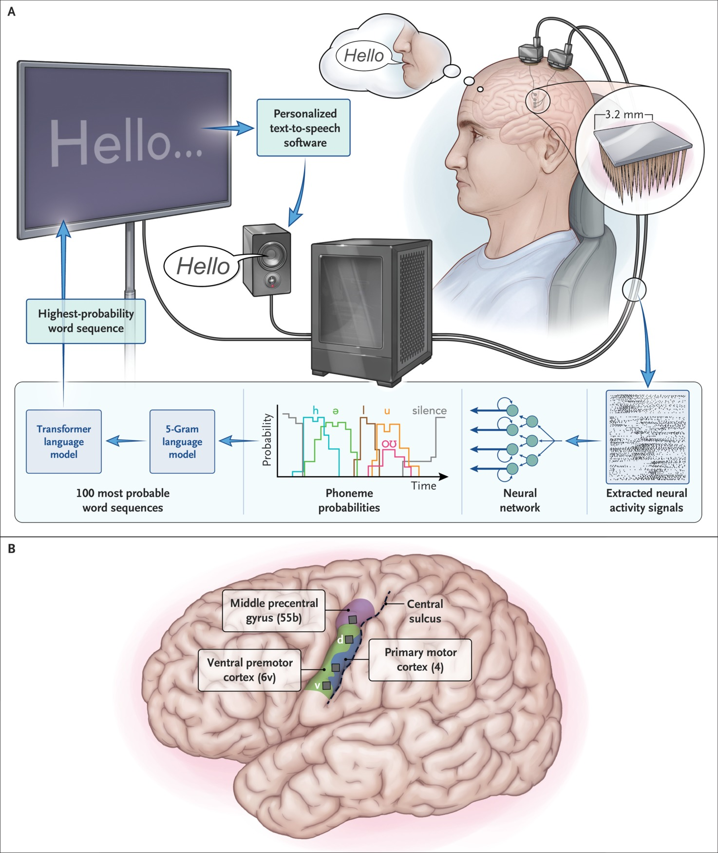
Electrode Locations and Speech-Decoding Setup.
Card NS et al. N Engl J Med2024;391:609-618
Notes:
Figure 1 Electrode Locations and Speech-Decoding Setup. Panel A shows the brain-to-text speech neuroprosthesis. Electrical activity is measured with the use of four 64-electrode arrays and processed to extract neural activity (see Section S1.04). Machine-learning techniques, incorporating an artificial neural network, are used to decode the extracted neural activity signals into an English phoneme every 80 msec (see also Section S5). Panel B shows the approximate microelectrode array locations (gray squares) superimposed on a three-dimensional reconstruction of the participant’s brain. Colored regions correspond to cortical areas²² aligned to the participant’s brain with the use of the Human Connectome Project MRI protocol scans before implantation.

Slide 5
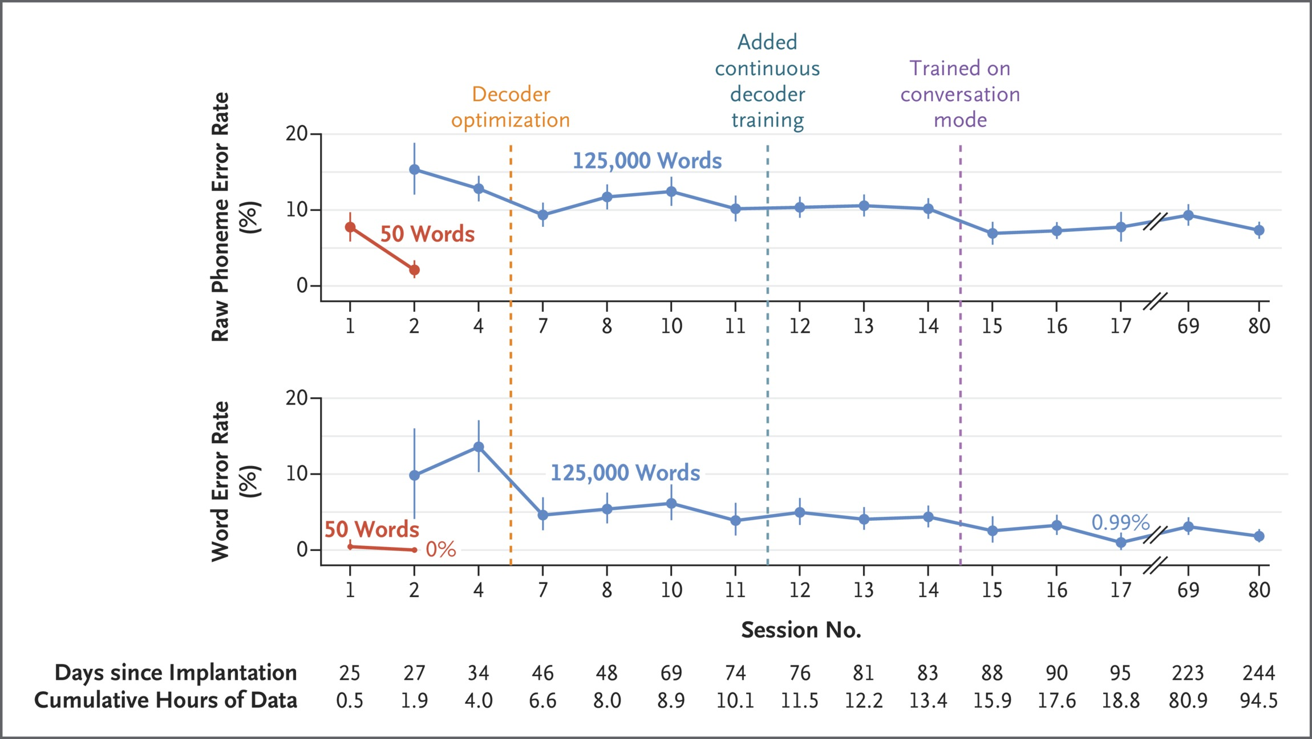
Online Speech-Decoding Performance.
Card NS et al. N Engl J Med2024;391:609-618
Notes:
Figure 2 Online Speech-Decoding Performance. Phoneme error rates (top) and word error rates (bottom) are shown for each session for two vocabulary sizes (50 and 125,000 words). These measures are calculated as the ratio of the number of phoneme or word errors to the total number of phonemes or words expected to be decoded, with the results expressed as percentages. The mean aggregate error rate across all evaluation sentences is shown for each session; error bars indicate the 95% confidence intervals. The hours row beneath the horizontal axis indicates the cumulative hours of neural data used to train the speech decoder for that session. Vertical dashed lines indicate times when decoder improvements were introduced. Fig. S20 shows phoneme and word error rates for individual blocks.

Slide 6
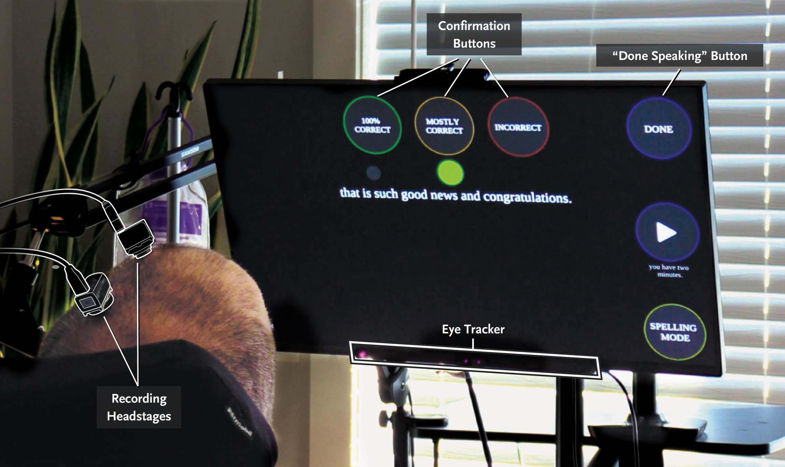
Conversation-Mode User Interface.
Card NS et al. N Engl J Med2024;391:609-618
Notes:
Figure 3 Conversation-Mode User Interface. A photograph of the participant using the speech neuroprosthesis in conversation mode is shown. The neuroprosthesis detected when the participant was trying to speak solely on the basis of neural activity and concluded either after 6 seconds of speech inactivity or on his optional activation of an on-screen button through eye tracking. After the decoded sentence was finalized, the participant selected on-screen confirmation buttons through eye tracking to indicate whether the decoded sentence was correct.

Slide 7
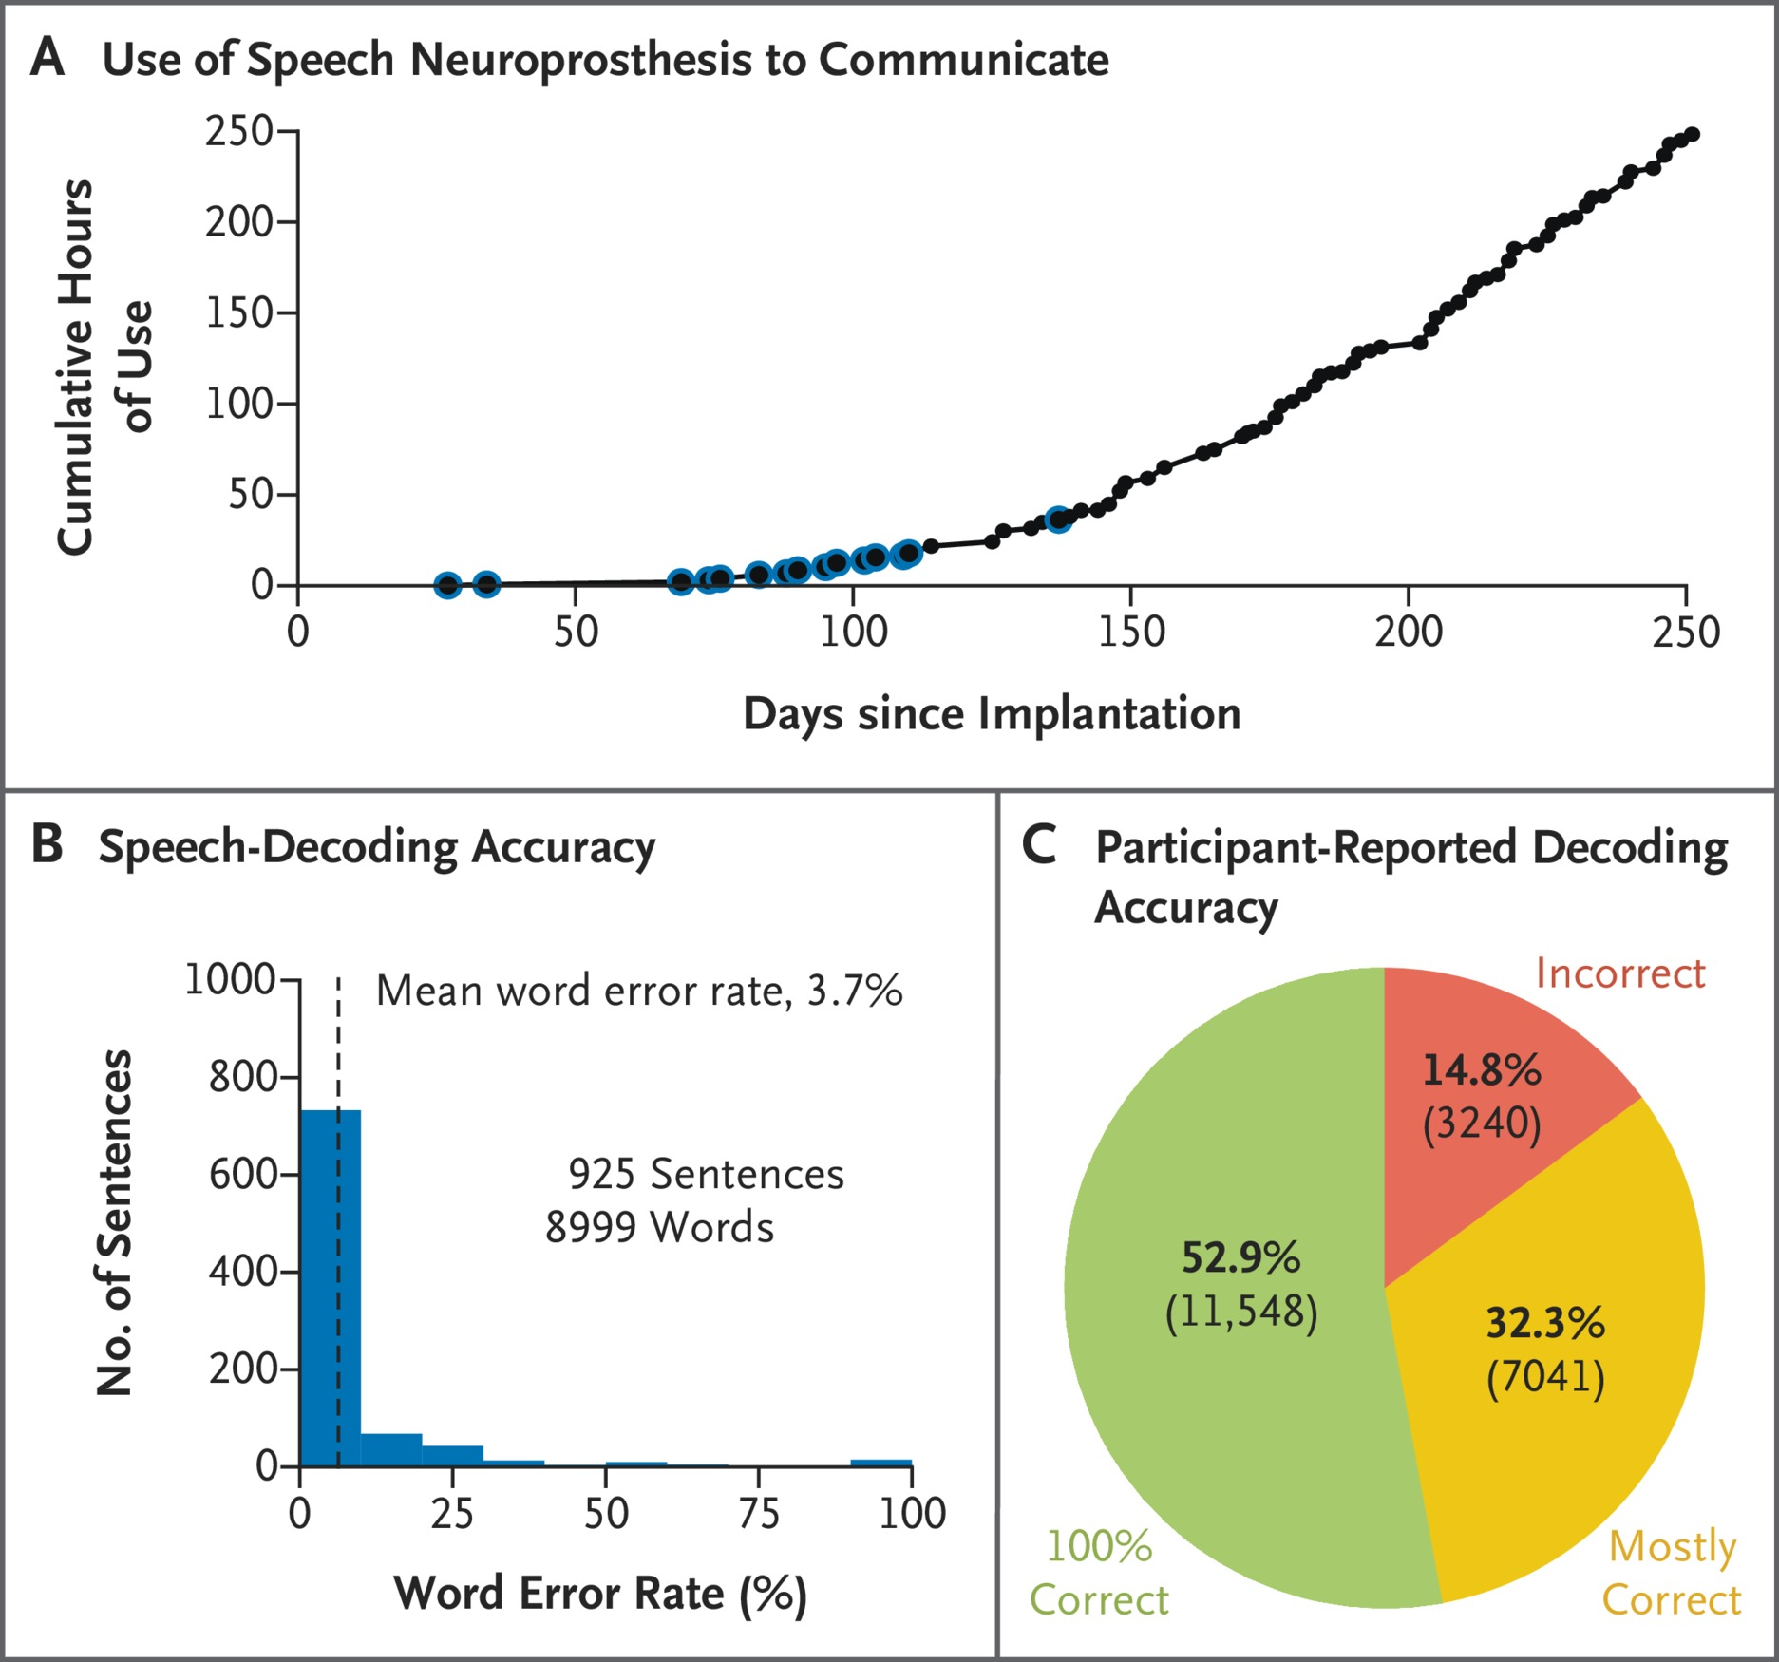
Use of the Neuroprosthesis for Participant-Initiated Speech.
Card NS et al. N Engl J Med2024;391:609-618
Notes:
Figure 4 Use of the Neuroprosthesis for Participant-Initiated Speech. Panel A shows the cumulative hours that the participant used the speech neuroprosthesis to communicate during structured research sessions and personal use. For the sessions outlined in blue, conversation-mode decoding accuracy was quantified as shown in Panel B. Panel B shows a histogram of speech decoding accuracy in conversations for the 925 sentences with known true labels (Section S1.09). The mean word error rate was 3.7% (95% CI, 3.3 to 4.3). Panel C shows participant-reported decoding accuracy for each sentence (which is different from the word error rate) across all conversation-mode data (21,829 sentences).

Slide 8
Conclusions
In a person with ALS and severe dysarthria, an intracortical speech neuroprosthesis reached a level of performance suitable to restore conversational communication after brief training.

